Slide 1
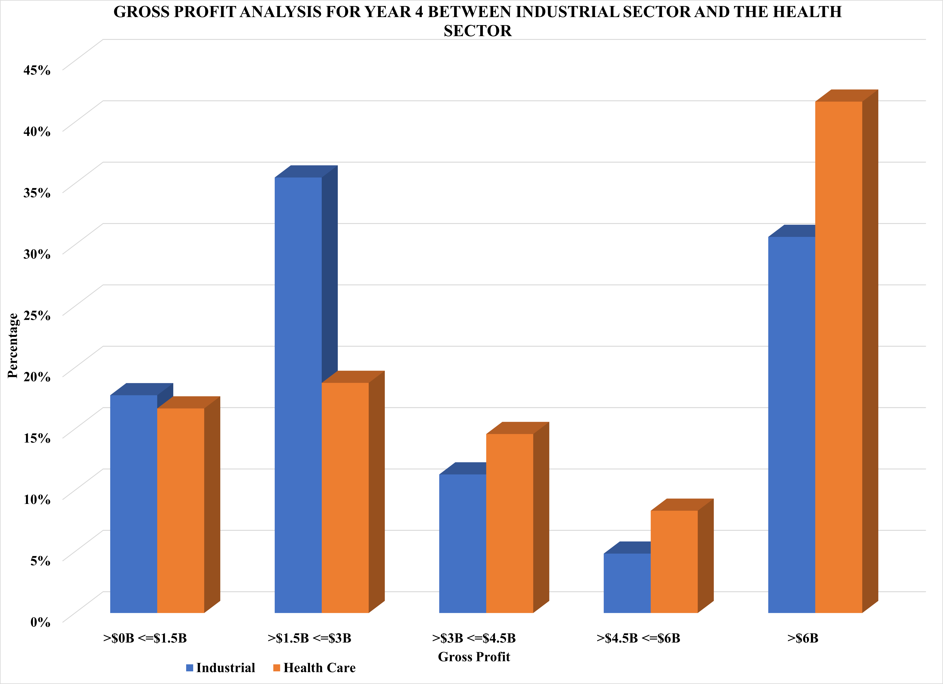
Comparative Analysis of Gross Profit Trends: Industrial vs. Health Care Sectors (Year 4)
The bar chart illustrate the gross profits of the Industrial and Health Care sectors for year 4, calculated as the difference between total revenue and the cost of goods sold. The distributions exhibit a Rightward skew, indicating positive skewness. Notably, the mean gross profit surpasses the median in both sectors.
In the Industrial sector, the mean gross profit is approximately $6 billion, while in the Health Care sector, it stands at around $9 billion. There is a significant difference in the medians, with the Health Care sector having a median gross profit of approximately $4 billion, compared to the Industrial sector's median of roughly $2.5 billion.
In terms of variability, the standard deviation for the Industrial sector is approximately $8.8 billion, while for the Health Care sector, it's about $12.4 billion. The health care sector has a higher range than the industrial sector. The Health care sector has a range of $66 Billion while the Industrial sector have a range of about $45 Billion.
Approximately 50% of the Industrial sector companies have a gross profit of $2.4 billion, while in the Health Care sector, 50% have a gross profit below $4.2 billion. The Industrial sector has a higher percentage of companies with gross profits between $1.5 billion and $3 billion. This could be attributed to the significant operational costs faced by Industrial companies, such as network maintenance, employee salaries, and marketing expenses. An increase in these costs without a corresponding boost in revenue can lead to a reduction in gross profit. In contrast, the Health Care sector has a higher percentage of companies with gross profits exceeding $6 billion Gross profit.

